Slide 1
SESSION 0 - INTRODUCTION
COWI Python Workshop

Slide 2
Workshop – Proposed structure
ADJUST SCHEDULE TO THIS COURSE
Session 1 – Intro
Overall introduction to Python
Showcase of example applications
Exercises
Session 2 – Basic concepts 1
Data structures
Loops and conditionals
Exercises
Session 3 – Basic concepts 2
Functions
Imports
Session 4 – Plotting
Customizing plot layouts
Subplots
Session 5 – Pandas
Manipulating tables with the Pandas package
Plotting heatmaps of data
Session 6 – ???
What do we want to do from here?
Split in groups according to interests?
Let’s discuss
Session 7 – …
…

Slide 3
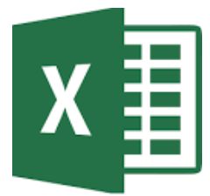
Excel
Excel is the right tool for many things, but it has some issues:
Keeping track of ranges is a very manual process --> prone to errors
Cell formulas, like nested IF-statements, can be very hard to read
It’s hard to reproduce problems or make sheets work for new problems
It’s slow for many rows (>100K)
Plots of data from filtrered table does not work well
Plots are not very dynamic
Advanced plots not available (colormaps, 3D, subplots etc.)
No option for ”equal axes” in plots (circular and sqaure shapes get distorted)
Version control almost non-existent
Some Excel work is already programming!
Python could be a good ”extension” for complex stuff we normally do in Excel

Slide 4

Why Python?
Engineering and data science
Powerful langauage
Easy to learn and concise syntax
Approachable for non-developers
Free to use and constantly improving
Free to use and Open Source
New versions and features often released
Huge community
Arguably most popular programming language right now
Lots of online material and sources to get help from
Built-in features and third-party libraries
Many functionalities already built in
Additional functionality from countless third-party libraries
Most notable ones: Numpy, Pandas, Matplotlib

Slide 5
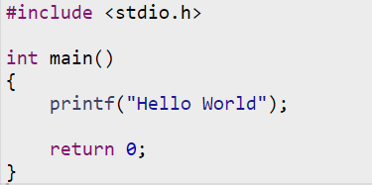

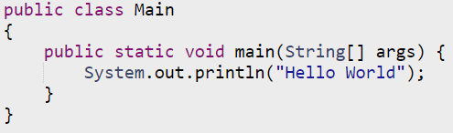

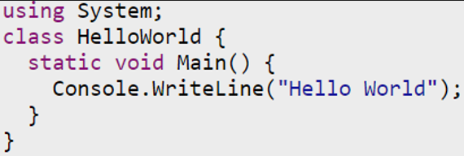
Hello World in six languages
C/C++
Fortran
Java
MATLAB
Python
C# (pronounced C-sharp)
Low level / High level languages
Simple explanation of why Python is so popular.

Slide 6
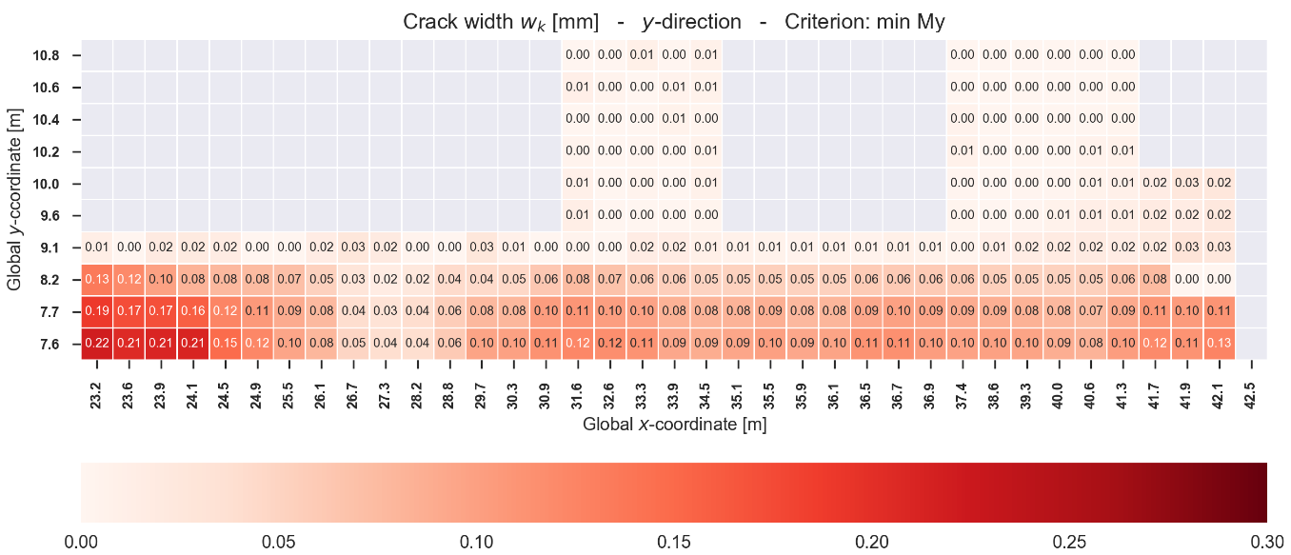
Examples - Plotting
Heatmap of crack widths in base slab
Keep or remove?

Slide 7
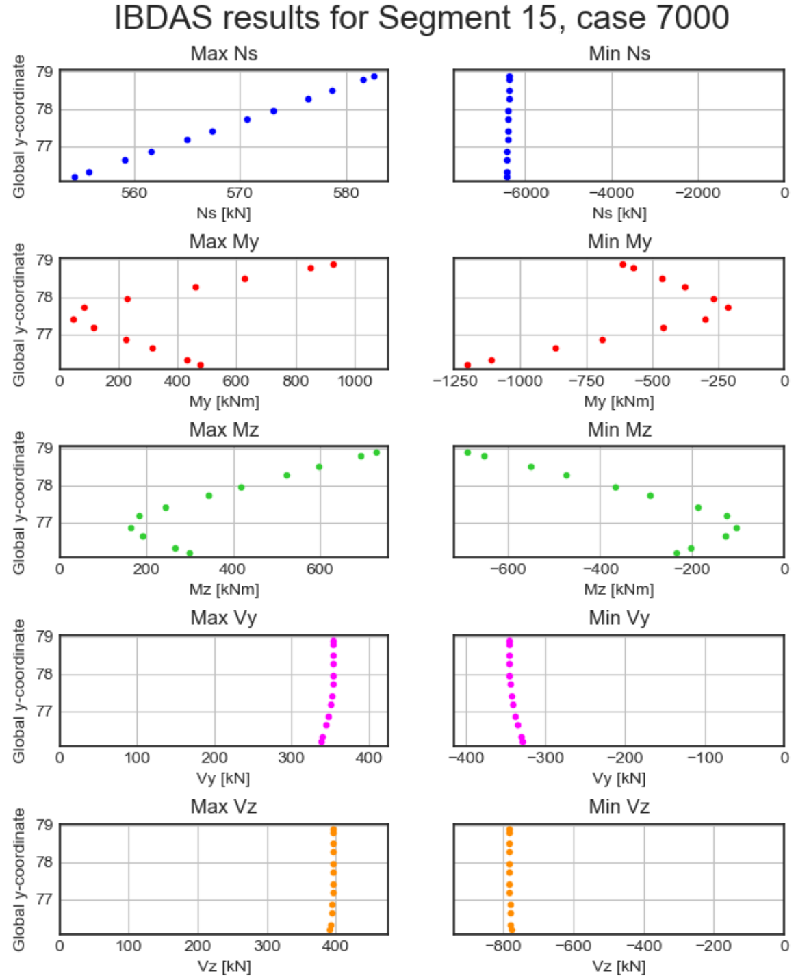
Examples – Plotting
IBDAS results for a column
Beam element
Large result file (show how it looks)
Results filtered and plotted
Results are envelopes This is the reason why points are not connected
Keep or remove?

Slide 8
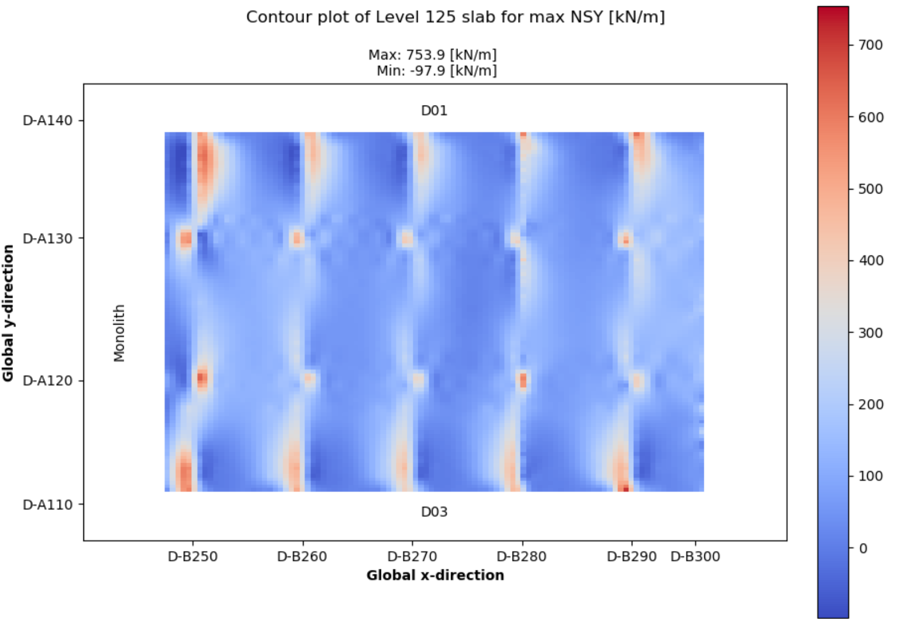
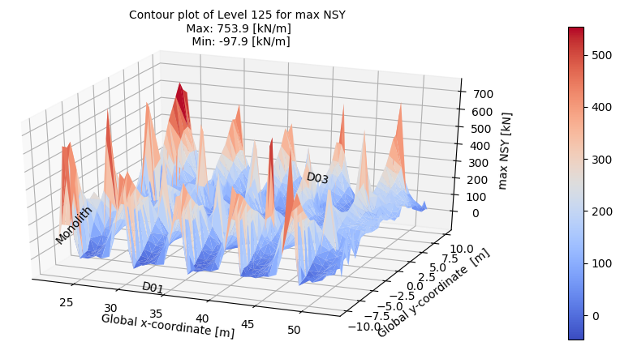
Examples - Plotting
1st floor slab results from IBDAS
Same results in two different plots
Custom text annotation
3D plot can be rotated
2D plot with custom gridlines

Slide 9
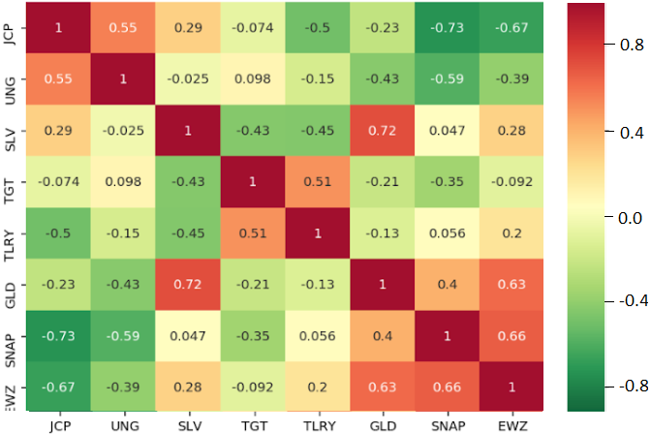
Examples - Plotting
Correlation matrix
Many time series boiled down to a graph
Correlation coefficient shown in each tile
Given a table/dataframe this plot can be produced in two lines of code
Scatter matrix example (plot everything vs eachother)
Remove

Slide 10
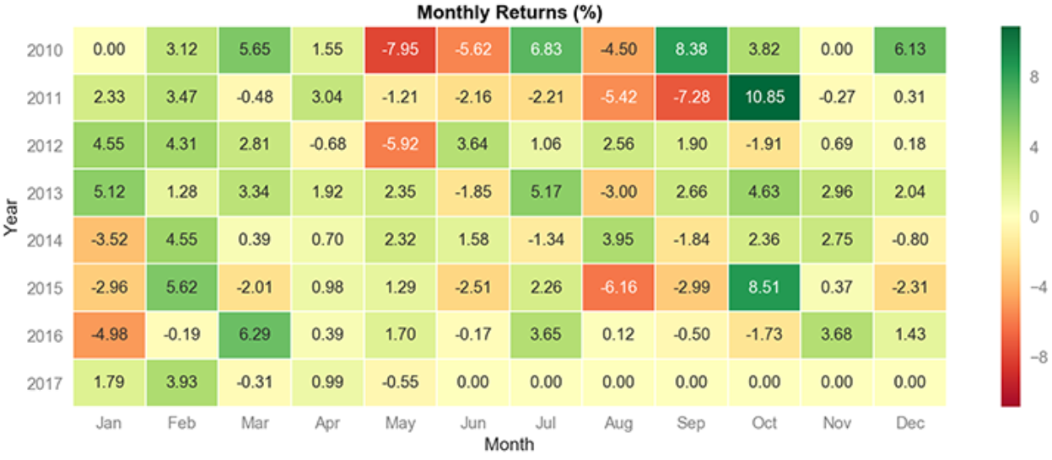
Examples - Plotting
Another heatmap example
Remove?

Slide 11
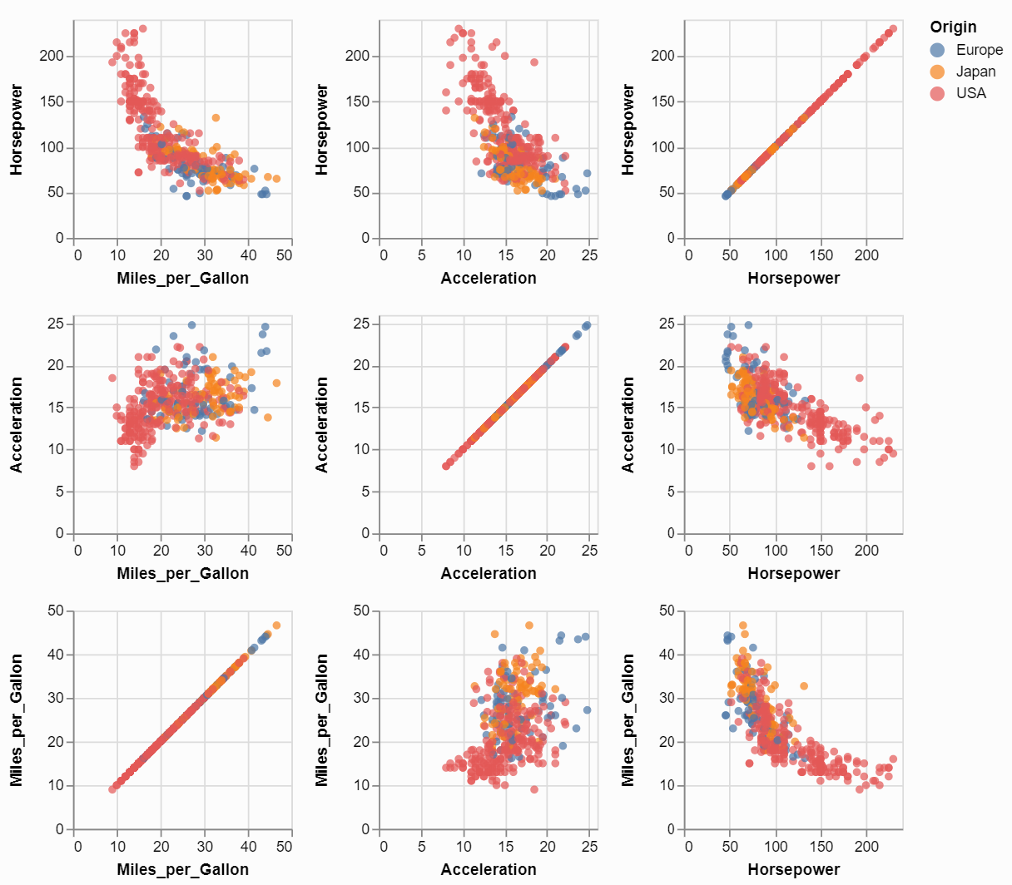
Examples - Plotting
Scatter matrix
Tiles are individual graphs
Everything plotted vs everything
Remove?

Slide 12
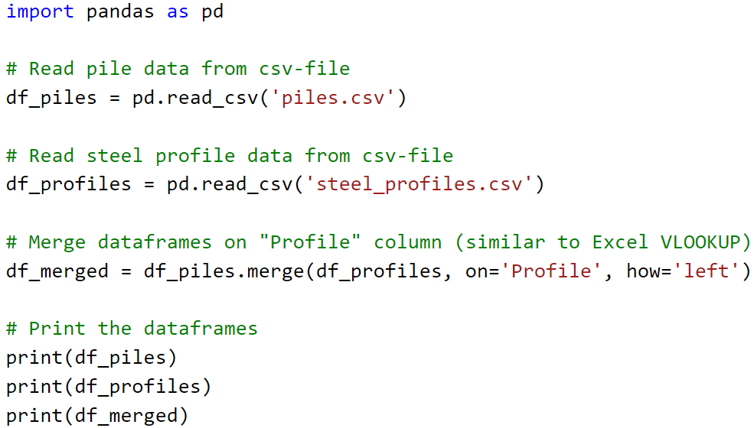
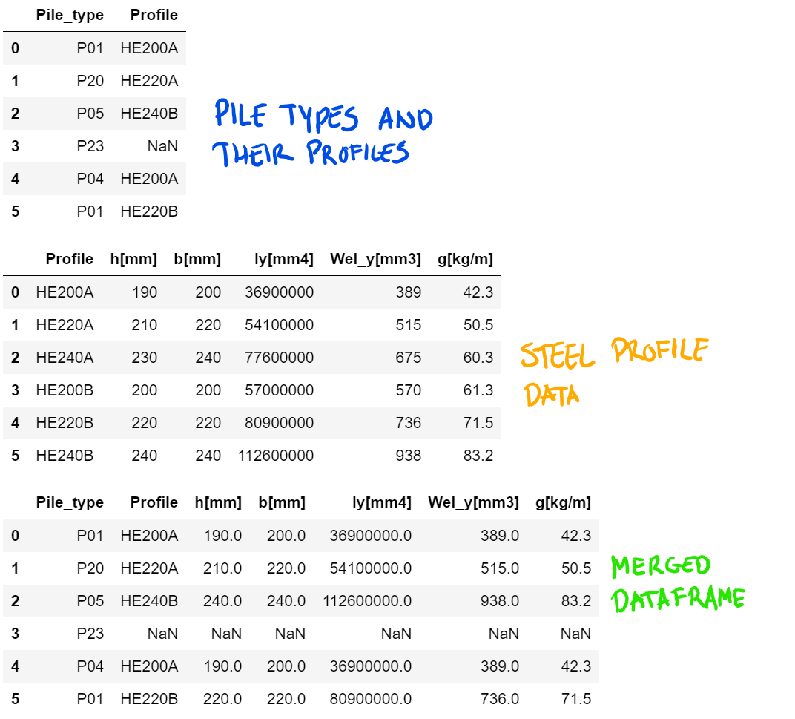
Panas dataframes - ‘VLOOKUP’ example
Code
Output
Scales with table sizes (both rows and columns)
Easily copied from one project to the next
Merged dataframe could be output as csv or xlsx-file to continue work in Excel

Slide 13
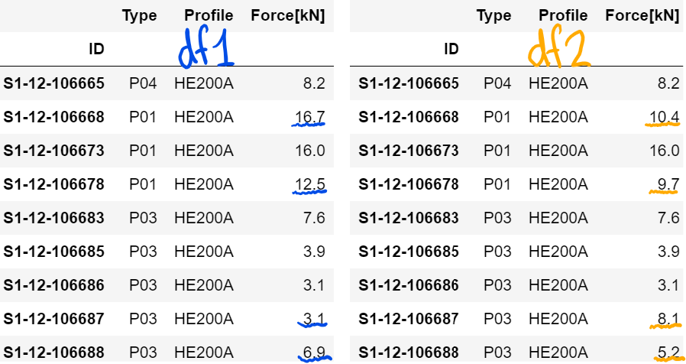
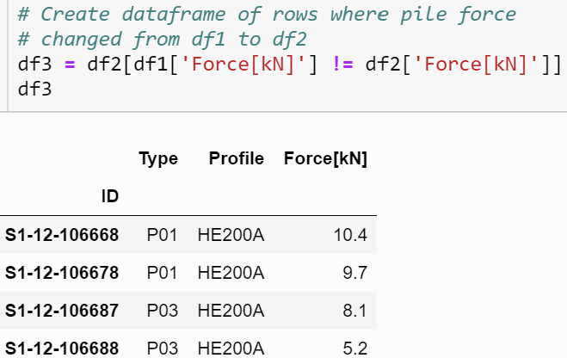
Dataframes - What changed bewteen versions?
Comparing versions of pile force data
New dataframe of only changed pile forces
One line of code
Useful for large datasets
Could be extended to show a lot more comparison details

Slide 14
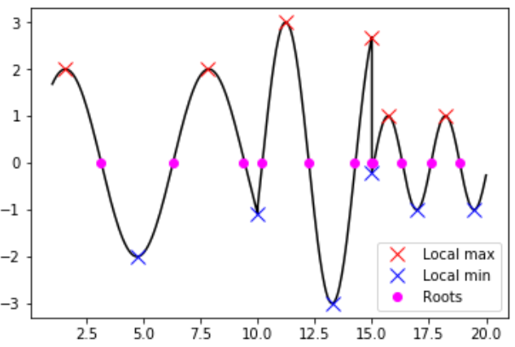
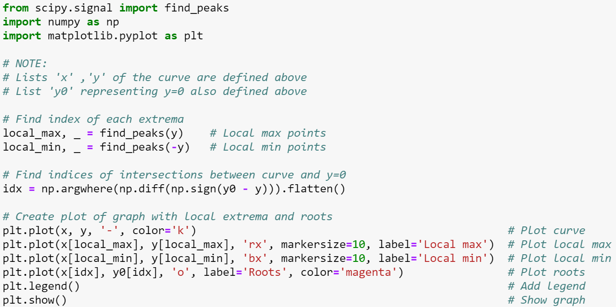
Scipy – example with peaks and roots
All points of interest found in three lines of code
Other lines are comments, imports and plotting

Slide 15
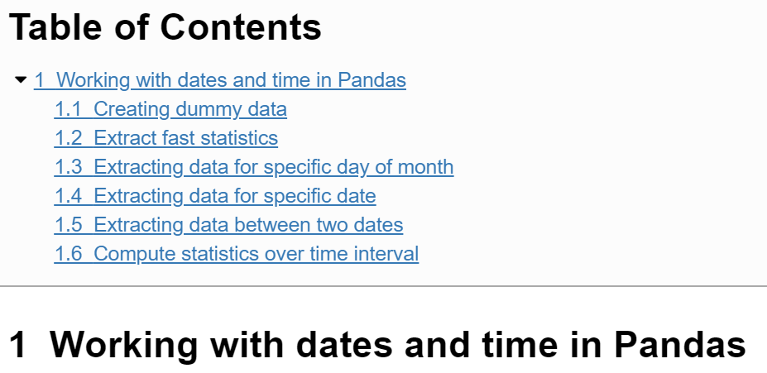
Dates and time in tables
Manipulate time series
Easy commands
Fast computations
Show demonstration in browser
(Jupyter Notebook)

Slide 16
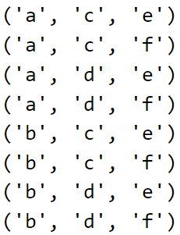
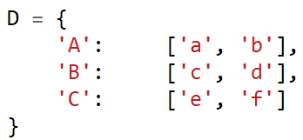


Other packages – Random and Itertools
Not great examples.
Too general. Remove?
Random
Simulate a roulette game
Itertools
Combinatorics (among other things)
Example: Create all possible load combinations:

Slide 17
Other packages - xlwings
Use Python with Excel
Much (if not all) functionality of VBA in Python environment
Access all subjects mentioned in prior slides
Put results calculated with Python into Excel sheets afterwards
Issue: sharing with people who does not have Python installed. Is it possible?
Note: There are other libraries that can talk to Excel Might be worth exploring!
Too general. Needs some example use cases if we have any.

Slide 18
Other things
Web scraping
Serch websites for information to use in projects
E.g.: find a table in COWI portal and get its contents
Scheduling of scripts
Make scripts run at a certain times or at specific intervals
Regular expressions
Search for any pattern in text
E.g.: Find all valid phone numbers in a text file
os library
Manipulate files, folders and other things in the operating system
Include KEKL SharePoint API

Slide 19
Other things
Version control
Track all changes to code in a project via Git/GitHub
Create branches and merge when they are matured
Testing
Setup tests to make sure that the changes did not break anything
Illustrate version control better.
Show a diffed file
Show branching workflow

Slide 20
Other things
New items that should be included:
PyMuPDF (incl. Drawing Checker Tool)
KEKL Sharepoint API

